Slide 1


The Role of Green Human Resources Management for Sustainable
Organization Development in Bangladesh
Submitted By:
Suborna Akter
Roll: 18019015
Major in HRM
Bangladesh University Of Professionals
Green HRM

Slide 2

Introduction
Green HRM is a strategic approach to HR with a focus on sustainability and environmental responsibility
Green HRM ensures that the organization complies with environmental regulations and reporting requirements
It aligns HR practices with the broader goal of sustainable organization development
Green HRM

Slide 3
Background of the Study
GHRM becomes crucial for organizations in Bangladesh to adopt environmentally friendly practices. It contributes to sustainable organizational development. Sustainable development implies growth that does not negatively impact resources to the extent that future generations suffer.
Green HRM

Slide 4
Research Question
What is the role of Green Human Resources Management (GHRM) in promoting sustainable organizational development?
Does GHRM Practices have an impact on sustainable organizational development through a possible mediating effect of concept of Green HRM?
Green HRM

Slide 5

Research Objective
To explore the significance of GHRM practices sustainable growth in the organization
To understand how GHRM can facilitate the integration of sustainability into organization Development.
To assess the relationships between specific GHRM practices and SOD
To investigate the mediating role of the GHRM concept.
Green HRM

Slide 6
Research Gap
The research in "The Role of Green Human Resource Management for Sustainable Organization Development in Bangladesh" lacks empirical studies within the Bangladeshi context.
While global knowledge on Green HRM is emerging, there is a dearth of empirical studies focused on specific HR practices within Bangladeshi organizations.
The absence of empirical research makes it challenging to assess the impact of Green HRM on sustainable organizational development in Bangladesh.

Slide 7
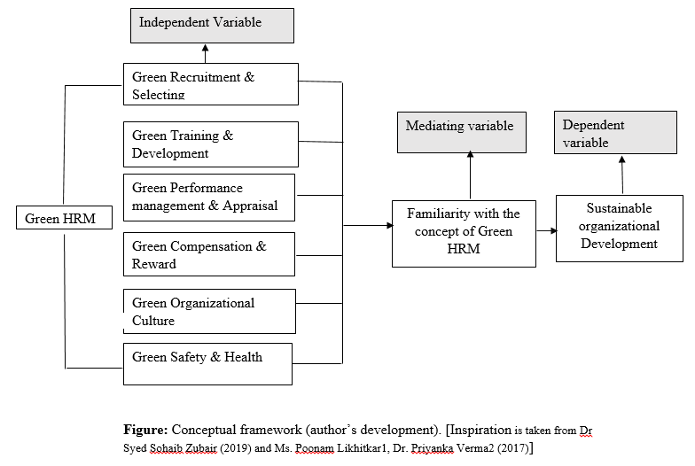
Research Model

Slide 8


Research Methodology
Data Sources
Primary data Sources: Primary data have been collected by using a questionnaire with relevant questions. Survey Conducted among the different manufacturing sector including High-Mid level HR professionals, distribute questionnaire – Likert 5 scale
Secondary Data Sources: The secondary data sources were identified for the literature and theoretical assessment of this study. Different journals, books, the internet and different reports have been used.

Slide 9
Research Methodology
Sampling Method Statistical quantitative sampling method is used Information was collected by conducting a survey to measure role of GHRM for sustainable organization Development Statistical tool helps researchers and marketers organize quantitative data gathered from experiments, questionnaires and more | Sample Size Sample size decisions were primarily based on Green HRM Practices for SOD Eventually the respondents were 100 These 100 respondents are the HR representatives and manager from different manufacturing organizations | Using Tools Analytical Tool Used Normality, test of reliability, multiple linear regression, Pearson Correlation Analysis, Mediation Analysis between the variables Computer software used here is MS Excel, and IBM SPSS® Statistics 29.0

Slide 10
Demographic profile of Respondents
Age Level | Percentage
24 - 30 | 62%
31 - 35 | 33%
36 - 45 | 4%
45 -Above | 1%
Total | 100%
Respondents Distribution (Age level wise)
PERCENTAGE
Male
64%
Female
36%
Respondents Age

Slide 11
Demographic profile of Respondents
Tenure of employment
Concept of Green HRM
PERCENTAGE
Yes
75%
No
25%

Slide 12
Hypotheses
Hypotheses 1
H1a: There is a significant relationship between recruitment & selecting and sustainable organizational development.
H1b: Concept of GHRM can Mediates relation between recruitment & selecting and sustainable organization development
Hypotheses 2
H2a: There is a relationship between training & development and sustainable organization development
H2b: Concept of GHRM can Mediates relation between training & development and sustainable organization development
Hypotheses 3
H3a: There is a relationship between performance Management & appraisal and sustainable organization development
H3b: Concept of GHRM can Mediates relation between performance management & appraisal and sustainable organization development
Organization
CULTURE

Slide 13
Hypotheses
Hypotheses 4
H4a: There is a relationship between Green Compensation & rewards and sustainable organization development
H4b: Concept of GHRM can Mediates relation between Compensation & rewards and sustainable organization development
Hypotheses 5
H5a: There is a significant relationship between organizational culture and sustainable organization development
H5b: Concept of GHRM can Mediates relation between Organizational Culture and sustainable organization development
Hypotheses 6
H6a: There is a significant relationship between Safety & health and sustainable organization development
H6b: Concept of GHRM can Mediates relation between Safety & health and sustainable organization development

Slide 14
Data analysis in SPSS software
Normality Analysis (above 0.05)
Reliability Analysis ( 0.859)-Good
Pearson correlation
Correlation among the variables (Independent, Dependent, Mediating)
Multiple Linear Regression
Independent variable: GHRM practices(RS,TD,PMA,CR,OS,SH)
Dependent Variable: SOD
Coefficient Tables generate to interpret the GHRM practices on SOD
Mediation Analysis
Represent the effect of a third variable between the relationship of independent and dependent variables

Slide 15
Key Findings
Indicate a strong positive relationship between Green Human Resource Management (GHRM) practices and Sustainable Organizational Development
Provide empirical support for the notion that integrating GHRM practices can enhance an organization's sustainable development efforts
Mediates the relationships between RS, TD, CR, and OC with SOD
GHRM concept does not mediate the relationships between performance management and appraisal and safety and health with SOD

Slide 16
Conclusion
Green Human Resource Management (GHRM) is an emerging field that holds immense potential in addressing environmental concerns and fostering sustainability within organizations.
Based on discussion, analysis, findings, it implies that the role of GHRM has a positive and significant influence for sustainable organization Development.
Furthermore, the research highlights the mediating role of GHRM in enhancing the relationships between these practices and SOD. This emphasizes the interconnectedness of these practices and the need for a comprehensive GHRM approach that transcends individual components.

Slide 17
Recommendations
Integration of GHRM Practices: Integrate specific Green Human Resource Management (GHRM) practices into their HR strategies, with a particular emphasis on the practices with Sustainable Organizational Development (SOD).
Embracing the GHRM Concept: Organizations should not view GHRM as a collection of isolated practices but rather embrace the broader concept of GHRM.
Continuous Improvement and Evaluation: Organizations should implement continuous improvement processes and regularly evaluate the effectiveness of their GHRM practices in achieving sustainability goals.
Industry-Specific Analysis: Future research can delve into industry-specific analysis, examining how GHRM practices impact sustainable development in different sectors within Bangladesh.

